Slide 1
Project : HOUSING PRICE PREDICTION
By R. Rajesh Kannan

Slide 2
Problem: US-based housing company Surprise Housing has decided to enter the Australian real estate market. To get profit the company uses data analytics to predict and purchase houses at a price below their actual values and flip them at a higher price. They need to know which features will affect price of the houses the most.

Slide 3
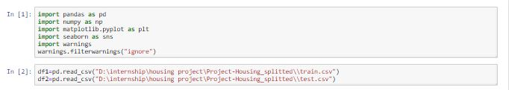
Import Libraries and read the data
Have to import the required libraries that we are going to use.
Have to read the data with pandas library

Slide 4
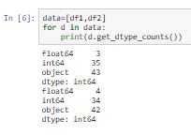
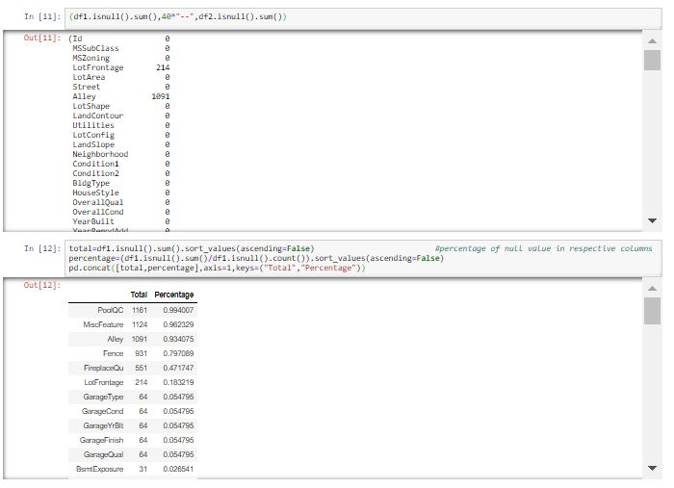
EDA Process: Checking of data type and presence of null values :
Data Type may,
Int
Float
Object
There are presence Null values with high percentage in some column.
Drop of null value leads to data loss so here I treat the null value.

Slide 5
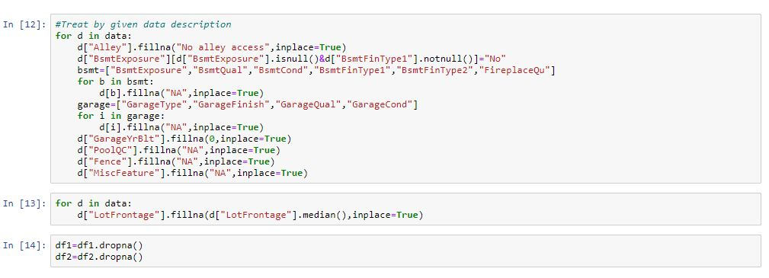
Treating of null values:
To treat that null value in some columns there are replacement value for null value mentioned in description then treat it by replacement method.
For remaining columns we have to treat it by apply mean for normal distributed data and median for skewed data and can apply mode for object data

Slide 6

Treat of unnecessary data and columns
Remove column ID because all value it contain are unique.

Slide 7

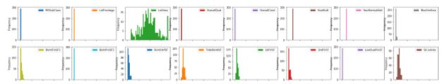
Checking of Outliers and Skewing the data
Values occur due to mistyping and wrong calculation are consider as outliers it can be find any of visualization method box plot, distribution plot, scatter plot but box plot is more suitable.
Skew of data can find by hist plot, columns have skew value above .55 or below -.55 are consider as skewed data, it can find by dataframe.skew() function

Slide 8
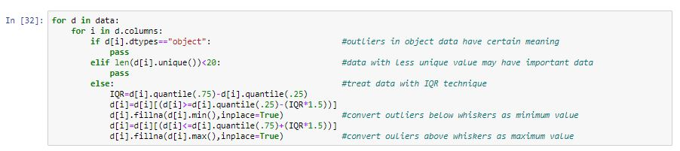
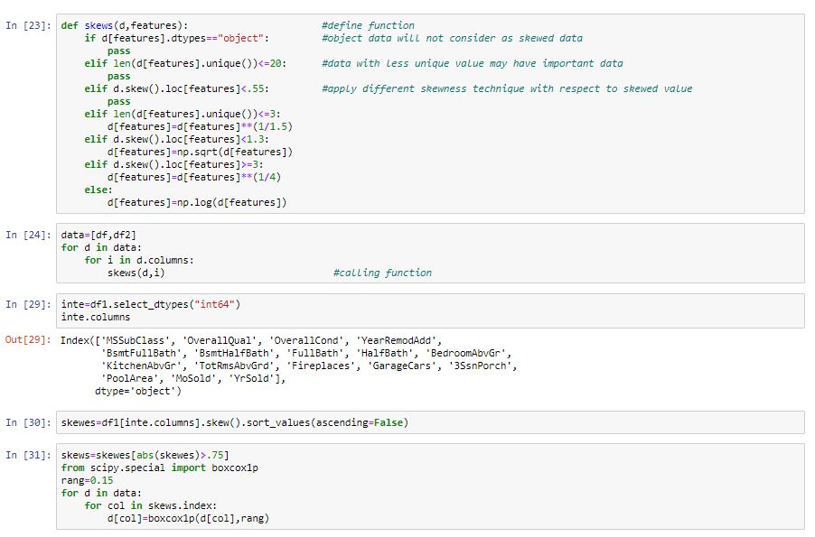
Outliers replacing and Skewing the data
Outliers can be replace or removed by ZScore or by IQR. Here I use IQR by replace outlier with maximum and minimum data for the respective input variable.
Skewing is by make mean, median, mode are near as possible. It can be done by Log, Square Root, Cube Root, boxcox and power transformation. Here I used Log, Square Root, Cube Root transformation and boxcox1p.

Slide 9
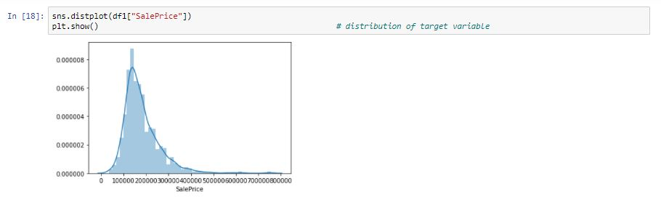
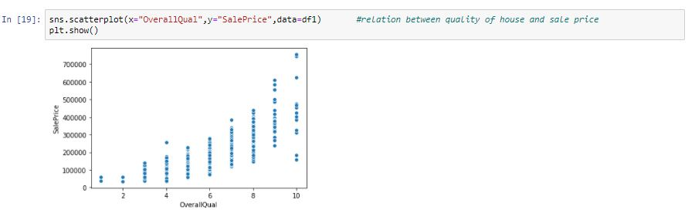
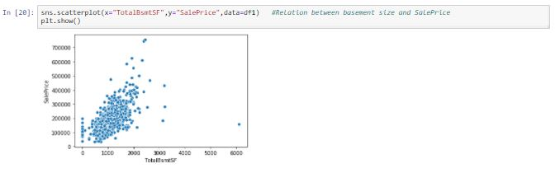
Visualization
Uni variant visualization:
Distribution of SalePrice:
It shows good distribution but slightly skewed.
Bi Variant analysis:
Relation between Output data and quality rate, size of basement, built year
Increase in quality rate of house leads to increase in SalePrice.
Large size basement leads to high sale price but there is presence of some outliers too

Slide 10
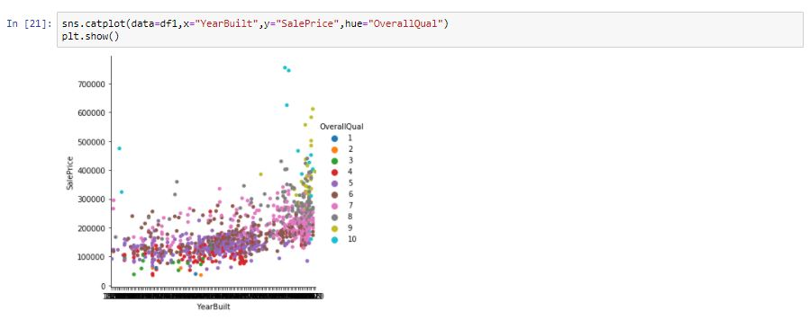
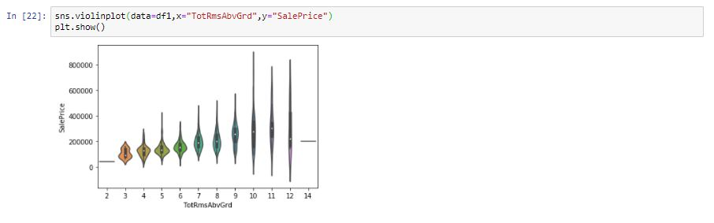
Based on built year the price of house slight increases and due to its quality it shows variances.
Increase high room number have to pay high may be for following reasons like quality and builtyear it get reduced for some house.

Slide 11
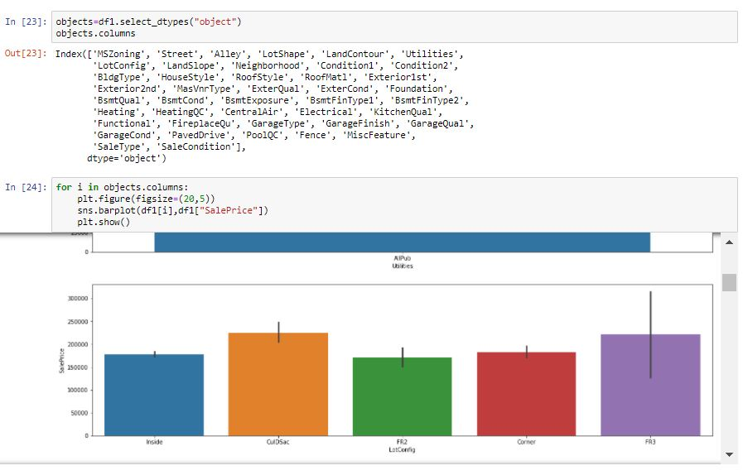
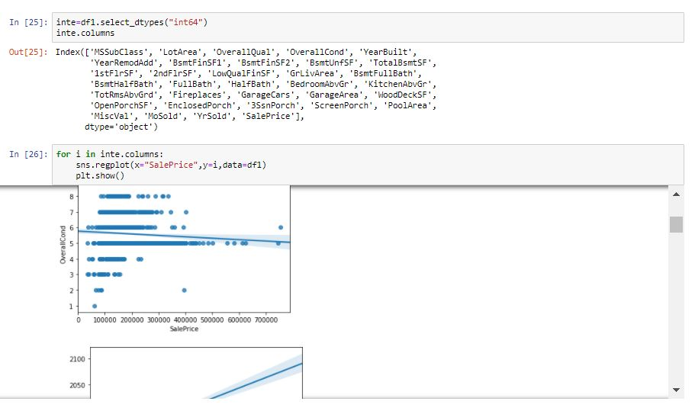
Bi-Variant Analysis for object and integer data type:
Fig 1 It shows the relation of each object variable with SalePrice.
Here we came to know based on which category in respective features the SalePrice get high or low.
Fig 2 It shows the relation of each integer variable with SalePrice it shows that there is presence of outliers.

Slide 12
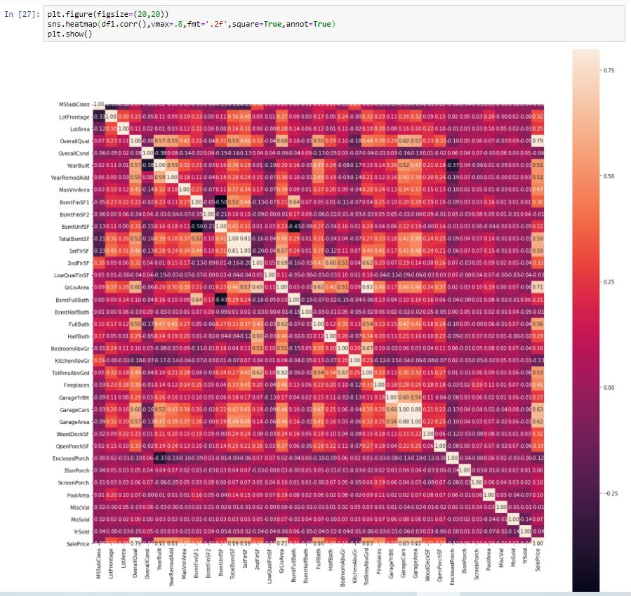
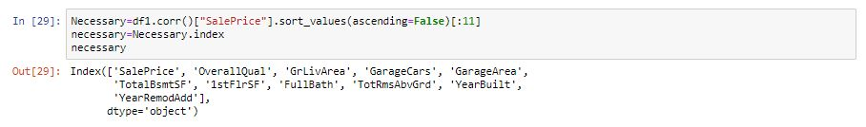
Multi variant analysis on necessary variables:
Correlation:
If near to 1 is strong +ve correlation
If near to 0 is normal correlation
IF near to -1 is strong –ve correlation
Input Variables which is strong correlated with output variable is the necessary variable.
Here OverallQual ,GrLivArea ,GarageCars , GarageArea ,TotalBsmtSF , 1stFlrSF, FullBath ,TotRmsAbvGrd, YearBuilt, YearRemodAdd are highly correlated with SalePrice so these are important variables to predict the SalesPrice.
So these are important variables to predict the SalesPrice.
Change in these variables leads to changes in target variable.

Slide 13
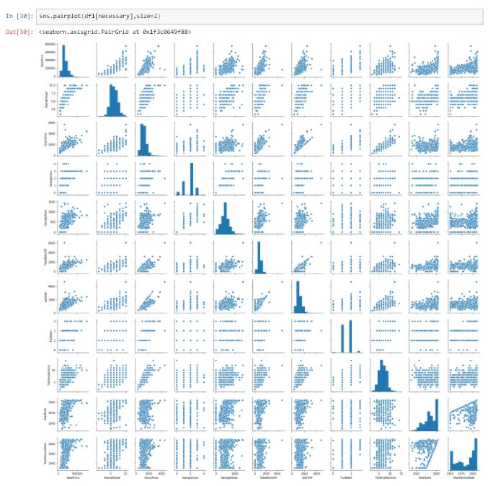
Relation between necessary columns
It shows that the Sale Price is increased based on Raise in Quality, full bath, GarageCars, TotRmsAbvGrd rate increase.
SalePrice is directly Proportional to variables such as GrLivArea,GarageArea, TotalBsmtSF, 1stFlrSF based on it raise and fall in SalePrice.
Based on variables YearBuilt, YearRemodAdd there will be slightly change in SalePrice

Slide 14
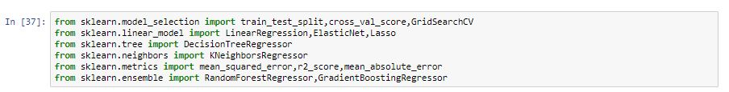
Model Selection and import
In Superwised ML there are classification and regression models. But here output variable have many unique values, so it will come under linear regression model.
Import the required model from sklearn library

Slide 15

Splitting of data
Have to split the data as input train and test, output train and test.
After the selection the best random state we have to find best model by getting good accuracy score, through train and test the data

Slide 16
Model fitting and prediction
Firstly have to fit the model,
Secondly have to train the input and output data in the respective models.
Have to check the score and select the best model by its score.
Then have to predict by test input data to get Sale Price of houses.

Slide 17
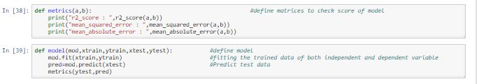
Model and matrix defining
I define 2nd,3rd and final steps in model user define function and metrics in matrix user define function
Make the required models in the list.
Use this we can predict Sale Price of House.

Slide 18
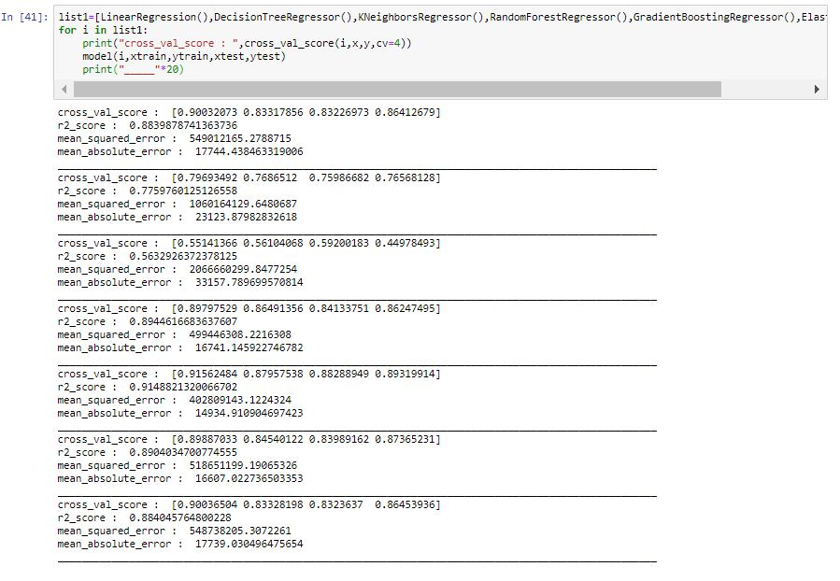
Model Prediction
Not only by above process we can find the best model because there may occur over fitting due to presence of high bias and high variance in it. So we have to do Cross Validation on it for right result.
So these models in the list have to iterate through cross validation, model and matrix user define function.

Slide 19
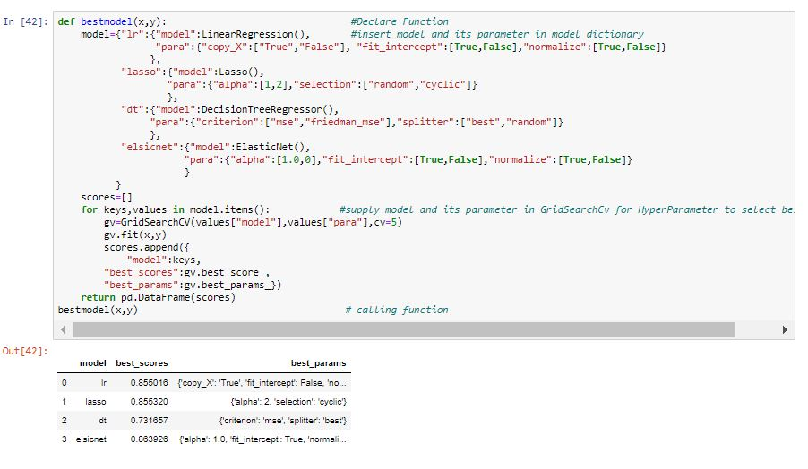
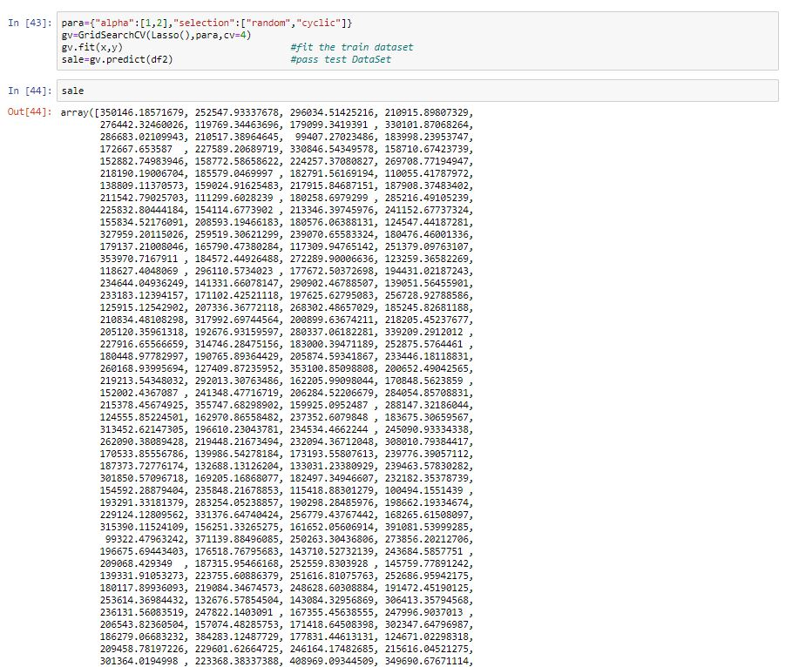
Hyper Parameter Tuning:
Fig1 For to improve the accuracy score for selected best model or all model, we have to apply Grid Search or Randomized search, by apply all the required parameters of respective model inside Grid Search we can get better accuracy.
ElasticNet gives a better result at 86.3%.
And also came to know the best parameters .
Fig2 Predict the Sale Price for test input by fit train data in ElasticNet model.

Slide 20
Finalized model
By compare the difference between Cross Validation Score and r2score we can select the less difference model as best and also consider its score after did Hyper Parameter Tuning.
If the model best score is high it will consider as better model ,if it is low it will not consider as good model
ElasticNet model is come under the above constrains.

Slide 21
Conclusion:
It concluded that there is some wrong data. By treat it and prediction was lead to get good model with 86.39 % as best score.
Observed data through visualization.
As the end we can Predict the Sale Price of house for test input by fit train data in the model with good score.

